Slide 1

8085 Interrupts
(Unit-3)
(Sub: Microprocessor and Interfaces)
PREPAREDBY:
ER. MOHIT MISHRA
ACEIT, JAIPUR

Slide 2
Interrupts
Interrupt is a process where an external device can get the attention of the microprocessor.
  The process starts from the I/O device
  The process is asynchronous.
Classification of Interrupts
  Interrupts can be classified into two types:
    Maskable Interrupts (Can be delayed or Rejected)
    Non-Maskable Interrupts (Can not be delayed or Rejected)
Interrupts can also be classified into:
    Vectored (the address of the service routine is hard-wired)
    Non-vectored (the address of the service routine needs to be supplied externally by the device)

Slide 3
Interrupts
An interrupt is considered to be an emergency signal that may be serviced.
  The Microprocessor may respond to it as soon as possible.
What happens when MP is interrupted ?
  When the Microprocessor receives an interrupt signal, it suspends the currently executing program and jumps to an Interrupt Service Routine (ISR) to respond to the incoming interrupt.
  Each interrupt will most probably have its own ISR.

Slide 4
Responding to Interrupts
Responding to an interrupt may be immediate or delayed depending on whether the interrupt is maskable or non-maskable and whether interrupts are being masked or not.
There are two ways of redirecting the execution to the ISR depending on whether the interrupt is vectored or non-vectored.
  Vectored: The address of the subroutine is already known to the Microprocessor
  Non Vectored: The device will have to supply the address of the subroutine to the Microprocessor

Slide 5
The 8085 Interrupts
When a device interrupts, it actually wants the MP to give a service which is equivalent to asking the MP to call a subroutine. This subroutine is called ISR (Interrupt Service Routine)
The ‘EI’ instruction is a one byte instruction and is used to Enable the non-maskable interrupts.
The ‘DI’ instruction is a one byte instruction and is used to Disable the non-maskable interrupts.
The 8085 has a single Non-Maskable interrupt.
  The non-maskable interrupt is not affected by the value of the Interrupt Enable flip flop.

Slide 6
The 8085 Interrupts
The 8085 has 5 interrupt inputs.
  The INTR input.
    The INTR input is the only non-vectored interrupt.
    INTR is maskable using the EI/DI instruction pair.
  RST 5.5, RST 6.5, RST 7.5 are all automatically vectored.
    RST 5.5, RST 6.5, and RST 7.5 are all maskable.
  TRAP is the only non-maskable interrupt in the 8085
    TRAP is also automatically vectored

Slide 7
The 8085 Interrupts
Interrupt name | Maskable | Vectored
INTR | Yes | No
RST 5.5 | Yes | Yes
RST 6.5 | Yes | Yes
RST 7.5 | Yes | Yes
TRAP | No | Yes

Slide 8
Interrupt Vector Tables and the Vector
An interrupt vector is a pointer to where the ISR is stored in memory.
All interrupts (vectored or otherwise) are mapped onto a memory area called the Interrupt Vector Table (IVT).
  The IVT is usually located in memory page 00 (0000H - 00FFH).
  The purpose of the IVT is to hold the vectors that redirect the microprocessor to the right place when an interrupt arrives.

Slide 9
Example: Let , a device interrupts the Microprocessor using the RST 7.5 interrupt line.
  Because the RST 7.5 interrupt is vectored, Microprocessor knows , in which memory location it has to go using a call instruction to get the ISR address. RST7.5 is knows as Call 003Ch to Microprocessor. Microprocessor goes to 003C location and will get a JMP instruction to the actual ISR address. The Microprocessor will then, jump to the ISR location

Slide 10
The 8085 Non-Vectored Interrupt Process
The interrupt process should be enabled using the EI instruction.
The 8085 checks for an interrupt during the execution of every instruction.
If INTR is high, MP completes current instruction, disables the interrupt and sends INTA (Interrupt acknowledge) signal to the device that interrupted
INTA allows the I/O device to send a RST instruction through data bus.
Upon receiving the INTA signal, MP saves the memory location of the next instruction on the stack and the program is transferred to ‘call’ location (ISR Call) specified by the RST instruction

Slide 11
The 8085 Non-Vectored Interrupt Process
Microprocessor Performs the ISR.
ISR must include the ‘EI’ instruction to enable the further interrupt within the program.
RET instruction at the end of the ISR allows the MP to retrieve the return address from the stack and the program is transferred back to where the program was interrupted.

Slide 12
The 8085 Non-Vectored Interrupt Process
The 8085 recognizes 8 RESTART instructions: RST0 - RST7.
  each of these would send the execution to a predetermined hard-wired memory location:
Restart Instruction | Equivalent to
RST0 | CALL 0000H
RST1 | CALL 0008H
RST2 | CALL 0010H
RST3 | CALL 0018H
RST4 | CALL 0020H
RST5 | CALL 0028H
RST6 | CALL 0030H
RST7 | CALL 0038H

Slide 13
Restart Sequence
The restart sequence is made up of three machine cycles
  In the 1st machine cycle:
    The microprocessor sends the INTA signal.
    While INTA is active the microprocessor reads the data lines expecting to receive, from the interrupting device, the opcode for the specific RST instruction.
  In the 2nd and 3rd machine cycles:
    the 16-bit address of the next instruction is saved on the stack.
    Then the microprocessor jumps to the address associated with the specified RST instruction.

Slide 14
Multiple Interrupts & Priorities
How do we allow multiple devices to interrupt using the INTR line?
  The microprocessor can only respond to one signal on INTR at a time.
  Therefore, we must allow the signal from only one of the devices to reach the microprocessor.
  We must assign some priority to the different devices and allow their signals to reach the microprocessor according to the priority.

Slide 15
The 8085 Maskable/Vectored Interrupts
The 8085 has 4 Masked/Vectored interrupt inputs.
  RST 5.5, RST 6.5, RST 7.5
    They are all maskable.
    They are automatically vectored according to the following table:
      The vectors for these interrupt fall in between the vectors for the RST instructions. That’s why they have names like RST 5.5 (RST 5 and a half).
Interrupt | Vector
RST 5.5 | 002CH
RST 6.5 | 0034H
RST 7.5 | 003CH

Slide 16
Masking RST 5.5, RST 6.5 and RST 7.5
These three interrupts are masked at two levels:
  Through the Interrupt Enable flip flop and the EI/DI instructions.
    The Interrupt Enable flip flop controls the whole maskable interrupt process.
  Through individual mask flip flops that control the availability of the individual interrupts.
    These flip flops control the interrupts individually.

Slide 17
The 8085 Maskable/Vectored Interrupt Process
The interrupt process should be enabled using the EI instruction.
The 8085 checks for an interrupt during the execution of every instruction.
If there is an interrupt, and if the interrupt is enabled using the interrupt mask, the microprocessor will complete the executing instruction, and reset the interrupt flip flop.
The microprocessor then executes a call instruction that sends the execution to the appropriate location in the interrupt vector table.

Slide 18
The 8085 Maskable/Vectored Interrupt Process
When the microprocessor executes the call instruction, it saves the address of the next instruction on the stack.
The microprocessor jumps to the specific service routine.
The service routine must include the instruction EI to re-enable the interrupt process.
At the end of the service routine, the RET instruction returns the execution to where the program was interrupted.

Slide 19
Manipulating the Masks
The Interrupt Enable flip flop is manipulated using the EI/DI instructions.
The individual masks for RST 5.5, RST 6.5 and RST 7.5 are manipulated using the SIM instruction.
  This instruction takes the bit pattern in the Accumulator and applies it to the interrupt mask enabling and disabling the specific interrupts.

Slide 20
How SIM Interprets the Accumulator
7
6
5
4
3
2
1
0
M7.5
M5.5
SDO
MSE
M6.5
SDE
R7.5
XXX
RST5.5 Mask
}
Serial Data Out
RST6.5 Mask
0 - Available
1 - Masked
RST7.5 Mask
Enable Serial Data
0 - Ignore bit 7
1 - Send bit 7 to SOD pin
Mask Set Enable
0 - Ignore bits 0-2
1 - Set the masks according
to bits 0-2
Not Used
Force RST7.5 Flip Flop to reset

Slide 21
SIM and the Interrupt Mask
Bit 0 is the mask for RST 5.5, bit 1 is the mask for RST 6.5 and bit 2 is the mask for RST 7.5.
    If the mask bit is 0, the interrupt is available.
    If the mask bit is 1, the interrupt is masked.
Bit 3 (Mask Set Enable - MSE) is an enable for setting the mask.
    If it is set to 0 the mask is ignored and the old settings remain.
    If it is set to 1, the new setting are applied.
    The SIM instruction is used for multiple purposes and not only for setting interrupt masks.
      It is also used to control functionality such as Serial Data Transmission.
      Therefore, bit 3 is necessary to tell the microprocessor whether or not the interrupt masks should be modified

Slide 22
SIM and the Interrupt Mask
The RST 7.5 interrupt is the only 8085 interrupt that has memory.
  If a signal on RST7.5 arrives while it is masked, a flip flop will remember the signal.
  When RST7.5 is unmasked, the microprocessor will be interrupted even if the device has removed the interrupt signal.
  This flip flop will be automatically reset when the microprocessor responds to an RST 7.5 interrupt.
Bit 4 of the accumulator in the SIM instruction allows explicitly resetting the RST 7.5 memory even if the microprocessor did not respond to it.
Bit 5 is not used by the SIM instruction

Slide 23
Using the SIM Instruction to Modify the Interrupt Masks
Example: Set the interrupt masks so that RST5.5 is enabled, RST6.5 is masked, and RST7.5 is enabled.
  First, determine the contents of the accumulator
M7.5
M6.5
SDO
MSE
M5.5
SDE
R7.5
XXX
- Enable 5.5 bit 0 = 0
- Disable 6.5 bit 1 = 1
- Enable 7.5 bit 2 = 0
- Allow setting the masks bit 3 = 1
- Don’t reset the flip flop bit 4 = 0
- Bit 5 is not used bit 5 = 0
- Don’t use serial data bit 6 = 0
- Serial data is ignored bit 7 = 0
0
0
0
0
1
0
1
0
Contents of accumulator are: 0AH
EI ; Enable interrupts including INTR
MVI A, 0A ; Prepare the mask to enable RST 7.5, and 5.5, disable 6.5
SIM ; Apply the settings RST masks

Slide 24
How RIM sets the Accumulator’s different bits
7
6
5
4
3
2
1
0
M7.5
M5.5
SDI
P6.5
IE
M6.5
P7.5
P5.5
RST5.5 Mask
}
Serial Data In
RST6.5 Mask
0 - Available
1 - Masked
RST7.5 Mask
RST5.5 Interrupt Pending
RST6.5 Interrupt Pending
RST7.5 Interrupt Pending
Interrupt Enable
Value of the Interrupt Enable
Flip Flop

Slide 25
The RIM Instruction and the Masks
Bits 0-2 show the current setting of the mask for each of RST 7.5, RST 6.5 and RST 5.5
    They return the contents of the three mask flip flops.
    They can be used by a program to read the mask settings in order to modify only the right mask.
Bit 3 shows whether the maskable interrupt process is enabled or not.
    It returns the contents of the Interrupt Enable Flip Flop.
    It can be used by a program to determine whether or not interrupts are enabled.

Slide 26
The RIM Instruction and the Masks
Bits 4-6 show whether or not there are pending interrupts on RST 7.5, RST 6.5, and RST 5.5
    Bits 4 and 5 return the current value of the RST5.5 and RST6.5 pins.
    Bit 6 returns the current value of the RST7.5 memory flip flop.
Bit 7 is used for Serial Data Input.
    The RIM instruction reads the value of the SID pin on the microprocessor and returns it in this bit.

Slide 27
Pending Interrupts
Since the 8085 has five interrupt lines, interrupts may occur during an ISR and remain pending.
  Using the RIM instruction, it is possible to can read the status of the interrupt lines and find if there are any pending interrupts.

Slide 28
TRAP
TRAP is the only non-maskable interrupt.
  It does not need to be enabled because it cannot be disabled.
It has the highest priority amongst interrupts.
It is edge and level sensitive.
  It needs to be high and stay high to be recognized.
  Once it is recognized, it won’t be recognized again until it goes low, then high again.
TRAP is usually used for power failure and emergency shutoff.

Slide 29
The 8085 Interrupts
Interrupt Name | Maskable | Masking Method | Vectored | Memory | Triggering Method
INTR | Yes | DI / EI | No | No | Level Sensitive
RST 5.5 / RST 6.5 | Yes | DI / EI SIM | Yes | No | Level Sensitive
RST 7.5 | Yes | DI / EI SIM | Yes | Yes | Edge Sensitive
TRAP | No | None | Yes | No | Level & Edge Sensitive

Slide 30
8259
Programmable Interrupt Controller
PREPARED BY:
ER. MOHIT MISHRA
CS DEPT.
ACEIT, JAIPUR

Slide 31
8259 Programmable Interrupt Controller
The 8259 programmable interrupt controller (PIC) adds eight vectored priority encoded interrupts to the microprocessor.
It accepts request from the peripheral equipment, determine which of the incoming requests is of the highest importance
Special features of 8259:
    Eight level priority controller
    Expandable to 64 levels
    Programmable interrupt modes
    Individual request mash capability

Slide 32
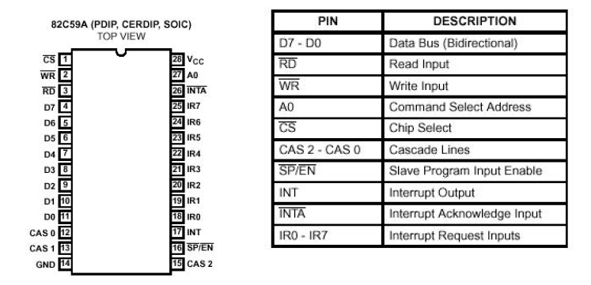
It is packaged in a 28-pin DIP, uses NMOS technology and requires a single a5V supply. Circuitry is static, requiring no clock input.
The 8259A is designed to minimize the software and real time overhead in handling multi-level priority interrupts.
It has several modes, permitting optimization for a variety of system requirements

Slide 33
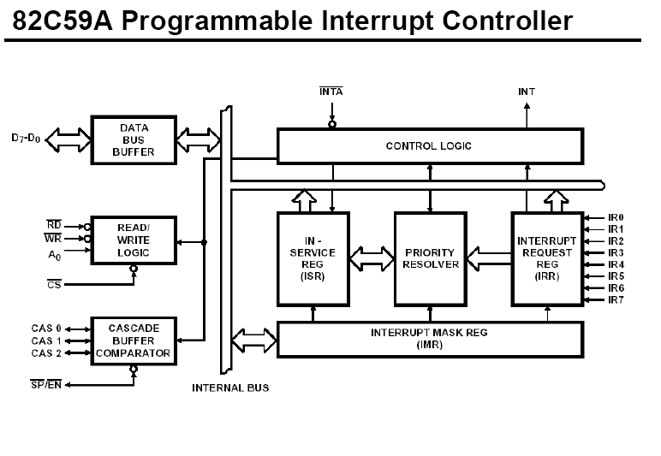

Slide 34
INTERRUPT REQUEST REGISTER (IRR) AND
IN-SERVICE REGISTER (ISR)
The interrupts at the IR input lines are handled by two registers in cascade, the Interrupt Request Register (IRR) and the In-Service (ISR). The IRR is used to store all the interrupt levels which are requesting service; and the ISR is used to store all the interrupt levels which are being serviced.
PRIORITY RESOLVER
This logic block determines the priorities of the bits set in the IRR. The highest priority is selected and stroed into the corresponding bit of the ISR during INTA pulse.
INTERRUPT MASK REGISTER (IMR
The IMR stores the bits which mask the interrupt lines to be masked. The IMR operates on the IRR. Masking of a higher priority input will not affect the interrupt request lines of lower quality.
INT (INTERRUPT)
This output goes directly to the CPU interrupt input. The V level on this line is designed to be fully compatible with the 8080A, 8085A and 8086 input
levels.

Slide 35
INTA (INTERRUPT ACKNOWLEDGE)
INTA pulses will cause the 8259A to release vectoring information onto the data bus. The format of this data depends on the system mode (mPM) of the 8259A.
DATA BUS BUFFER
This 3-state, bidirectional 8-bit buffer is used to interface the 8259A to the system Data Bus. Control words and status information are transferred through the Data Bus Buffer.
READ/WRITE CONTROL LOGIC
The function of this block is to accept Output commands from the CPU. It contains the Initialization Command Word (ICW) registers and Operation Command Word (OCW) registers which store the various control formats for device operation. This function block also allows the status of the 8259A to be transferred onto the Data Bus.
CS (CHIP SELECT)
A LOW on this input enables the 8259A. No reading or writing of the chip will occur unless the device is selected.
WR (WRITE)
A LOW on this input enables the CPU to write control words (ICWs and OCWs) to the 8259A.
RD (READ)
A LOW on this input enables the 8259A to send the status of the Interrupt Request Register (IRR), In Service Register (ISR), the Interrupt Mask Register (IMR), or the Interrupt level onto the Data Bus.
A0
This input signal is used in conjunction with WR and RD signals to write commands into the various command registers, as well as reading the various status registers of the chip. This line can be tied directly to one of the address lines
.

Slide 36
INTERRUPT SEQUENCE
The events occur as follows in an MCS-80/85 system:
1. One or more of the INTERRUPT REQUEST lines (IR7±0) are raised high, setting the corresponding IRR bit(s).
2. The 8259A evaluates these requests, and sends an INT to the CPU, if appropriate.
3. The CPU acknowledges the INT and responds with an INTA pulse.
4. Upon receiving an INTA from the CPU group, the highest priority ISR bit is set, and the corresponding IRR bit is reset. The 8259A will also release a CALL instruction code (11001101) onto the 8-bitData Bus through its D7±0 pins.
5. This CALL instruction will initiate two more INTA pulses to be sent to the 8259A from the CPU group.
6. These two INTA pulses allow the 8259A to release its preprogrammed subroutine address onto the Data Bus. The lower 8-bit address is released at the first INTA pulse and the higher 8-bitaddress is released at the second INTA pulse.
7. This completes the 3-byte CALL instruction released by the 8259A. In the AEOI mode the ISR bit is reset at the end of the third INTA pulse. Otherwise, the ISR bit remains set until an appropriate EOI command is issued at the end of the interrupt sequence.

Slide 37
PROGRAMMING THE 8259A
The 8259A accepts two types of command words generated by the CPU:
Initialization Command Words (ICWs):
Before normal operation can begin, each 8259A in the system must be brought to a starting point -by WR pulses.
2. Operation Command Words (OCWs): These are the command words which command the 8259A to operate in various interrupt modes.
These modes are:
a. Fully nested mode
b. Rotating priority mode
c. Special mask mode
d. Polled mode
The OCWs can be written into the 8259A anytime after initialization.

